Slide 1
CS2105 Introduction to Computer Networks

Slide 2
Recap
Application architecture
Client Server
Server
Always – on to wait for incoming requests
Provides the requested service to client
Client
Initiates contacts with the server
Requests services from the server
P2P
No always on server
No clear distinction between client and server
Any end host can be a client in 1 communication and yet be the server in another
Very scalable
Hybrid
Whatsapp
Notes:
Whatsapp’s server will have the contact details and other relevant information for reaching the person
The actual messaging is p2p

Slide 3
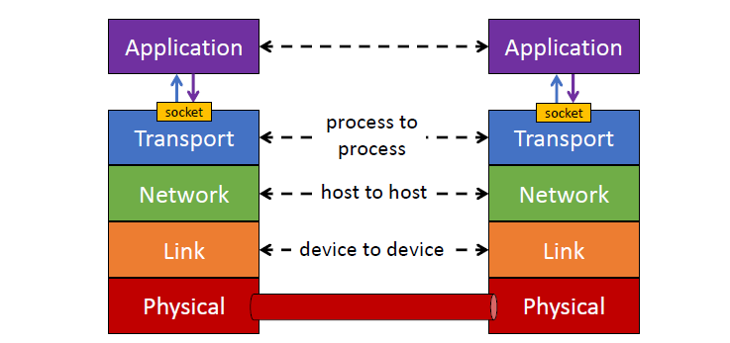
Recap
Sockets
Interface through which a process (application) communicates with the transport layer
Notes:
Depending on UDP TCP, different kinds of sockets: welcome/server socket
Sockets are used differently by the protocols
For eg, demultiplexed differently
UDP – destination IP, destination port (identify source by network layer)
TCP – source IP, source port, destination IP, destination port
Will be discussed more meaningfully when we explore TCP and UDP transport layer protocols

Slide 4
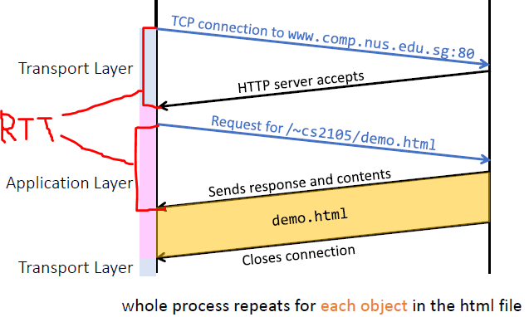
Recap
HTTP 1.0
Non persistent
For each web resource, a brand new TCP connection request has to be sent out
Sequential
Massive overhead since each file has to be loaded 1 by 1
Notes:
Try to rationalise the labelling of the transport and application layers (direction of going up and down the OSI stack in message exchange)

Slide 5
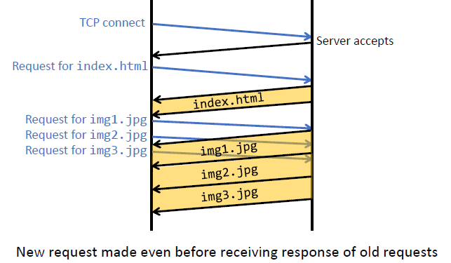
Recap
HTTP 1.1
Persistent
Only 1 TCP connection request is required to load ALL the relevant files/HTML objects
Connection is left open after sending a web object.
Less overhead
Pipelined
New requests can be made even before receiving responses for older requests.
HOWEVER, they have to be received back in the order they were requested
Head-of-line blocking
NOTE: HTML file is always loaded first!
Notes:
Notice that only TCP connection is established only once
Please also note that index.html (the HTML file) is always loaded first.
Only after loading the HTML file, then you will know what resources are needed to be fetched; can be thought of as the blueprint for the web resource -> only after reading the blueprint, you will know what you need to fetch.

Slide 6
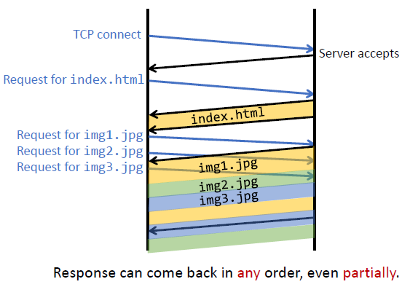
Recap
HTTP 2.0
In addition to being persistent and pipelined, it is multiplexing
Since fractions of the file can be received at different times, heavy requests will not block server
Head of line blocking faced by 1.1 solved

Slide 7
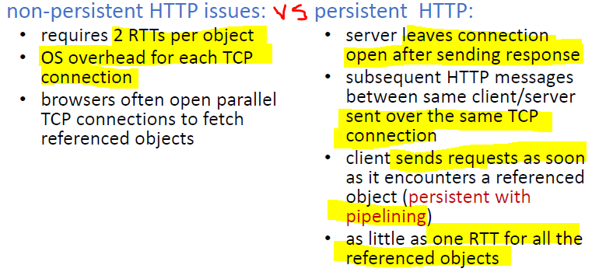
Recap
Notes:
non-persistent HTTP response time is hence 2*RTT + file transmission time ( 1 for TCP, 1 for the actual resource)

Slide 8
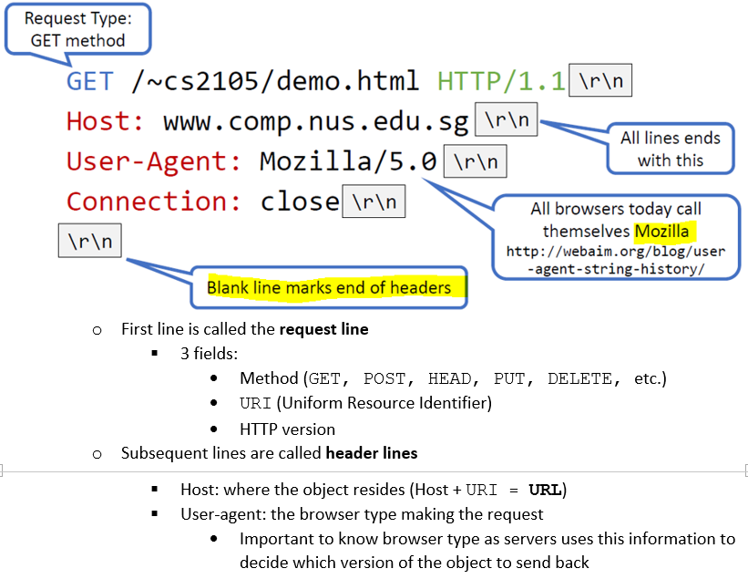
Recap
Notes:
Example HTTP request
Take note of conventions (\r\n)
Get used to what the different requests are – POST, GET, DELETE, PUT
User-agent is basically a way to tell the server what you are. Hi I’m mozilla on windows ☺ etc
Web server can use this information to serve different web pages to different web browsers and different operating systems.
If using a mobile platform, send a mobile friendly version of the site, if IE, please don’t use IE etc

Slide 9
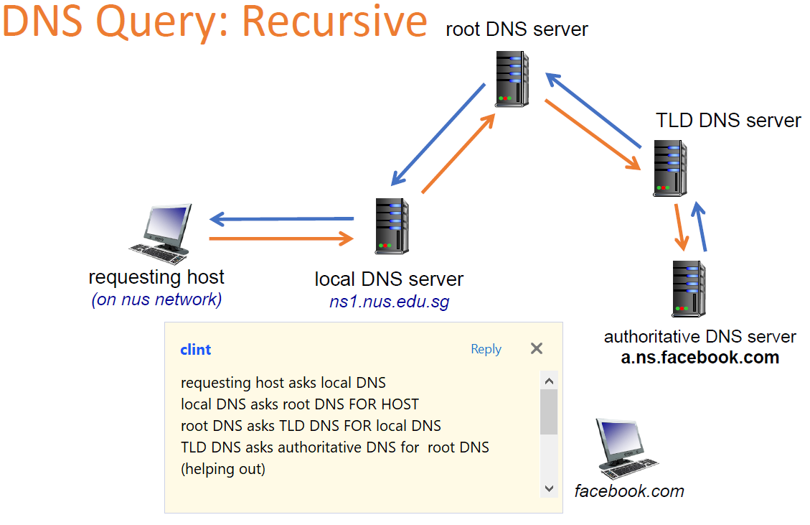
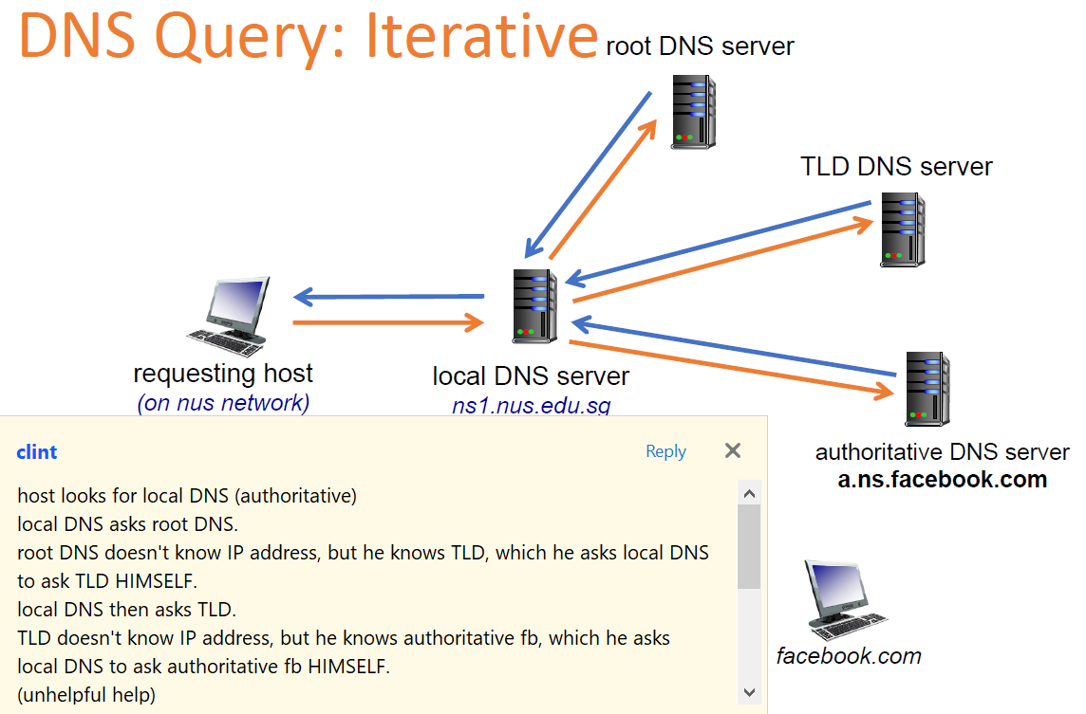
Recap
DNS
Runs on UDP. Why?
Listens on port 53
Application layer protocol
Acts as a contact book to translates a host’s name to its corresponding IP address
Recursive vs Iterative
Notes:
DNS also runs on UDP because it is lightweight and resource-friendly: setting up TCP connections just for a query is ‘overkill’ and wasteful.
** This is generally the case but certainly not a blanket truism. Motivations for TCP based DNSes are beyond the scope of CS2105, and you can just assume that DNS runs on UDP port 53 for the scope of CS2105. (for those interested, look up zone transfers bringing about large payloads that want to leverage on TCP fault handling mechanisms to reconstruct the message.)
DNS is just a service that translates host names into IP addresses, and is in effect an application that is invoked to help out the HTTP application, and therefore does not sit "below" HTTP in the OSI stack.
"what IP addresses are associated with thisparticularwebsite.com?”

Slide 10
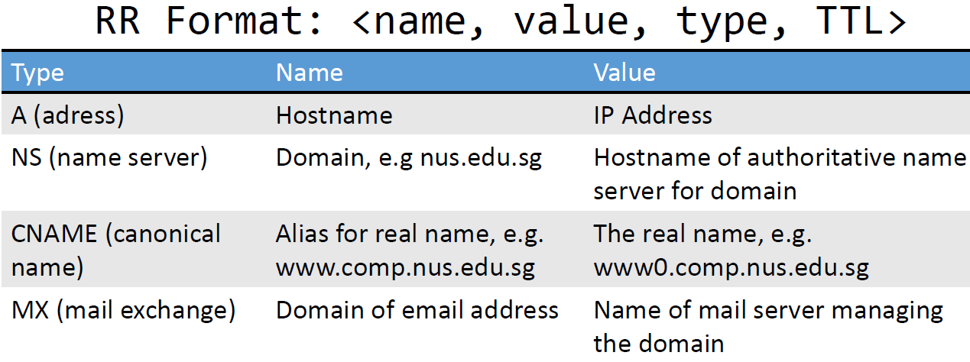
Recap
DNS
Resources are cached as resource records
Stored on local DNS servers
Every DNS query from a host is first sent to its local DNS server
Checks local cache to see if it already has a RR that stores the name to address translation for the query
Can find: saves a lot of time; else needs to go through
root → TLD server → authoritative server
Cannot be found: Local DNS server then acts as a proxy to forward query into hierarchy if address is not found in the local cache
Notes:
This is what comes up when you do a dig command ☺

Slide 11
Tutorial Questions

Slide 12
Question 1
Consider the following HTTP request message sent by a browser.
GET /~cs2105/demo.html HTTP/1.1
Host: www.comp.nus.edu.sg
Connection: keep-alive
Accept: text/html,application/xhtml+xml,application/xml;q=0.9,image/webp,*/*;q=0.8
User-Agent: Mozilla/5.0 (Windows NT 6.1; WOW64) AppleWebKit/537.36 (KHTML, like Gecko) Chrome/39.0.2171.99 Safari/537.36
Accept-Encoding: gzip, deflate, sdch
Accept-Language: en-US,en;q=0.8
a) What is the URL of the document requested by this browser?
www.comp.nus.edu.sg/~cs2105/demo.html
b) What version of HTTP is this browser running?
HTTP version 1.1
c) Does the browser request a non-persistent or a persistent connection?
The browser requests a persistent connection, as indicated by the header field ‘Connection: keep-alive’.
d) What is the IP address of the host on which the browser is running?
IP address is not shown in HTTP message. One would be able to get such information from socket.

Slide 13
Question 2
The text below shows the header of the response message sent from the server in reply to the HTTP GET message in Q1 above. Answer the following questions.
HTTP/1.1 200 OK
Date: Tue, 20 Jan 2015 10:08:12 GMT
Server: Apache/2.4.6 (Unix) OpenSSL/1.0.1h
Accept-Ranges: bytes
Content-Length: 73
Keep-Alive: timeout=5, max=100
Connection: Keep-Alive
Content-Type: text/html
a) Was the server able to successfully find the document or not?
The status code 200 and the phrase OK indicates that the server was able to locate the document successfully.
b) What time did the server send the HTTP response message?
The HTTP response message was formed on Tuesday, 20 Jan 2015 10:08:12 Greenwich Mean Time.
c) How many bytes are there in the document being returned?
There are 73 bytes in the document being returned.
d) Did the server agree to a persistent connection?
The server agreed to a persistent connection, as indicated by the header field ‘Connection: Keep-Alive field’.

Slide 14
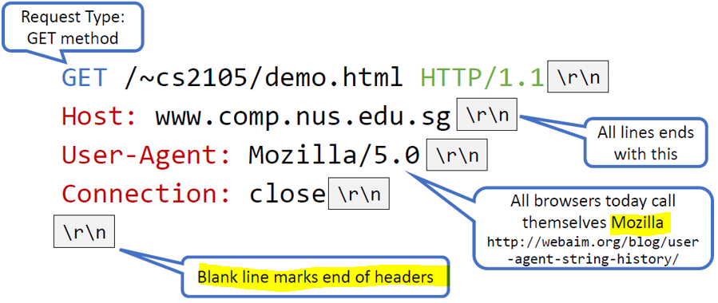
Question 3a
A user requests a Web page that consists of some text and three images. For this page, the client will send one request message and receive four response messages.
False. Download one object per request.
Notes:
Recall the example from before, the request line’s 3 fields: method, URI and version.
Notice how they are differentiated – by a single space character (this is the protocol’s standard)
You can’t have multiple URIs squeezed into the request line then

Slide 15
Question 3b, 3c & 3d
b) Two distinct Web pages (for example, www.mit.edu/research.html and www.mit.edu/students.html) can be sent over the same persistent connection.
True. They are on the same server.
c) The Date: header in the HTTP response message indicates when the object in the response was last modified.
False. Header field ‘Date’ indicates the server response time. The time the object is last modified is denoted by another header field ‘Last-Modified’.
d) HTTP response messages never have an empty message body.
False. E.g. conditional GET whereby browser’s cached copy is up-to-date.
Notes:
b) Basically all these web objects and relevant html files are all stored on some server. Since with this connection, I’ve already gotten the IP of all these servers, I can issue multiple requests with the same connection.

Slide 16
Question 4
[Modified from KR, Chapter 2, P7] Suppose within your Web browser, you click on a link to obtain a Web page. The IP address for the associated URL is not cached in your local host, so a DNS lookup is necessary to obtain the IP address.
Suppose that n DNS servers are visited before your host receives the IP address from DNS; visiting them incurs an RTT of D_{DNS} per DNS server.
Further suppose that the Web page associated with the link contains m very small objects (in addition to the HTML page). Suppose the HTTP running is non-persistent and non-parallel. Let D_{Web} denote the RTT between the local host and the server of each object.
Assuming zero transmission time of each object, how much time elapses from when the client clicks on the link until the client receives all the objects?
To map from hostname to IP address: n x D_{DNS} (note: DNS is over UDP, so no need to establish connection).
To establish TCP connection and get the HTML page = D_{Web} + D_{Web}
To establish m TCP connections and get all m objects = m x (D_{Web} + D_{Web})
Total time = n x D_{DNS} + (m + 1) x 2 x D_{Web}

Slide 17
Question 5
[Modified from KR, Chapter 2, P8] Referring to the previous question, suppose that three DNS servers are visited. Further, the HTML file references five very small objects on the same server. Neglecting transmission delay, how much time elapses with:
a) Non-persistent HTTP with no parallel TCP connections?
3 x D_{DNS} + (5 + 1) x 2 x D_{Web} [Note that the 1 is for the HTML file!]
b) Non-persistent HTTP with the browser configured for five parallel connections?
3 x D_{DNS} + 2 x D_{Web} + 2 x D_{web} [for HTML file]
Need to fetch HTML file first (2 x D_{Web}). Subsequently, the rest 5 objects can be fetched in parallel each using a TCP connection (2 x D_{Web}).
c) Persistent HTTP with pipelining?
3 x D_{DNS} + 2 x D_{Web} + D_{web} [for HTML file]
Need to fetch HTML file first (2 x D_{Web}). The rest 5 objects can be fetched through the same TCP connection in parallel – no RTT for TCP handshake is needed.
Notes:
As explained in Q4
5 parallel -> after fetching the HTML web page, you can fetch the rest in parallel, amounting to only 2 RTT (ie 2 * D_{Web}, 1 for TCP connection establishment, 1 for object)
Persistent with pipelining -> connection not closed, don’t need the 2nd D_{Web} for subsequent objects.
Note that the number of DNS queries is independent of the persistency or parallel-ness of the connection.

Slide 18
Question 6
Do you know what is DNS cache poisoning? Search online for a real example.
DNS cache poisoning (a kind of DNS spoofing) is a computer hacking attack, whereby rogue DNS records are introduced into a DNS resolver’s cache, causing the name server to return an incorrect IP address, diverting traffic to the attacker’s computer (or any other computer). For example, DDoS (Distributed Denial of Service Attack) on a particular machine can be achieved via DNS cache poisoning.
Examples:
1. DNS Poisoning in China: http://www.howtogeek.com/161808/htg-explains-what-is-dns-cache-poisoning/
2. Angry Bird Website Defaced: https://arstechnica.com/security/2014/01/angry-birds-website-defaced-following-reports-it-enables-government-spying/
Notes:
Mappings within the RR are ‘poisoned’, leading the users to wrong IP addresses.

Slide 19
Question 8
1. What is the status code returned from the server to your browser?
Ans: 200
2. When was the HTML file that you are retrieving last modified at the server?
Ans: the value is denoted by the header field ‘Last-Modified’.

Slide 20
Summary
Application architecture
Sockets
HTTP 1.0 vs 1.1 vs 2.0 (important!!)
HTTP Requests and Responses
DNS

Slide 21
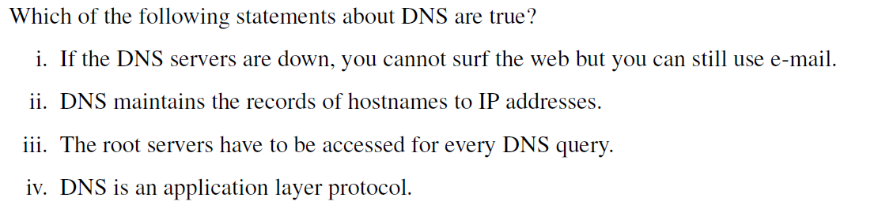
Extra Questions
Notes:
Verify the options, could be a combination!

Slide 22
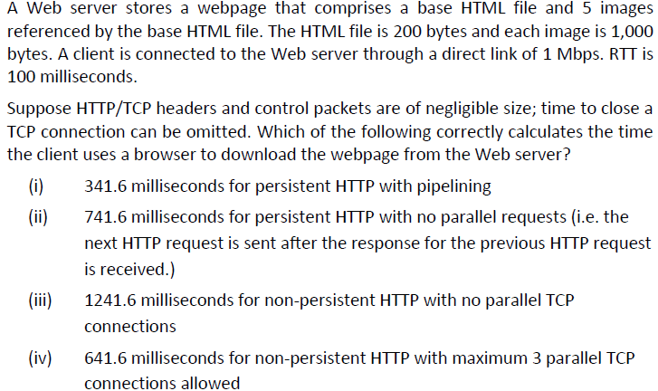
Extra Questions
Notes:
Verify the options, could be a combination!

Slide 23
Thank you!
Answers:
ii & iv
All are correct!

